Slide 1

Deep Dive into Azure AI Search for Gen AI Apps

Slide 2

About me
Formerly:
Data Scientist in Defense, Healthcare industries
Arpita Parmar
Sr. Azure AI/ML Consultant at Microsoft

Slide 3
Today we’ll discuss
Retrieval-augmented generation (RAG)​
Vectors and vector databases​
Retrieval modes with Azure AI Search​
Integrated Vectorization

Slide 4
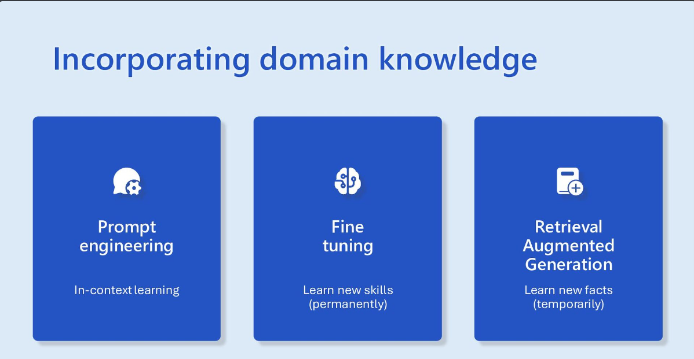

Slide 5






Retrieval Augmented Generation Grounding truth in your data for intelligent applications
-2, -1 , 0, 1
Azure AI Search
Data Sources (files, databases, etc.)
2, 3, 4, 5
6, 7, 8, 9
Query → Knowledge
Transform into Embeddings
Prompt + Knowledge → Response
App UX
Orchestrator
Azure OpenAI Service

Slide 6
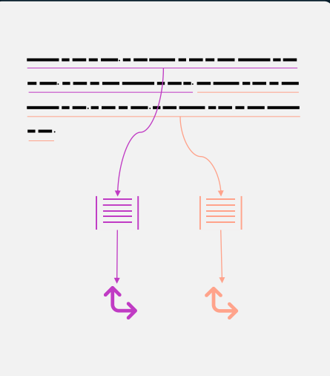
Data ingestion for RAG
Chunking
Split long-form text into short passages
LLM context length limits
Focused subset of the content
Basics chunking
200–500 tokens/passage
Maintain lexical or logical boundaries
overlap
Layout chunking
e.g., tables
Vectorization
Indexing-time: convert passages to vectors

Slide 7
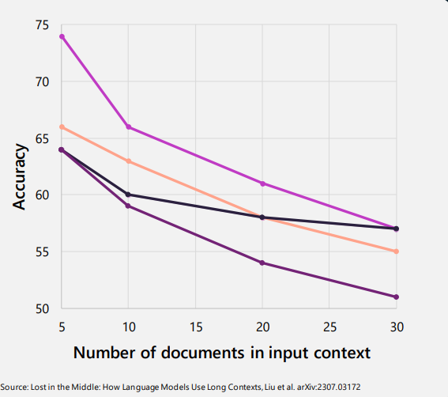
Retrieval quality

Slide 8
Vectors, Vector based retrieval and Vector databases

Slide 9
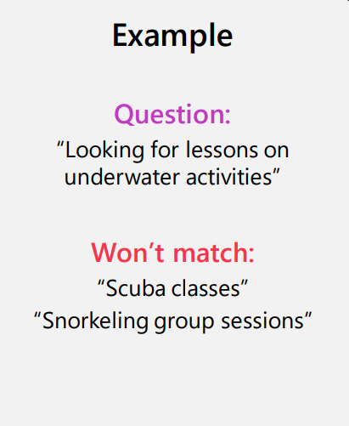
Responses are only as good as retrieved data
Keyword search limitations
vocabulary gap
Struggle to capture nuances in language

Slide 10
Traditional Search
Document 1:
“apple orange banana”
Term | Freq | Documents
apple | 3 | 1, 2, 3
orange | 2 | 1, 2
banana | 2 | 1, 3
grape | 2 | 2, 3
Document 2:
“orange apple grape”
Document 3:
“banana grape apple”
Dictionary
Postings Lists

Slide 11
Ranking & Relevance in Traditional Search
Relevance : Retrieve documents containing specific terms (e.g., "apples" AND "oranges")
Ranking via BM25: A ranking algorithm influenced by 3 key factors:
Term Frequency (TF): More occurrences of the search term indicate higher relevance
Inverse Document Frequency (IDF): The rarer a term across documents, the more important it is.
Field Length: Terms found in shorter fields (fewer words) are more likely to be relevant than terms in longer fields (more words)

Slide 12
Embeddings: Universal representation of data
3.4MB
0.1912
0.4123
4.1MB
. . .
0.9128
1.1GB

Slide 13
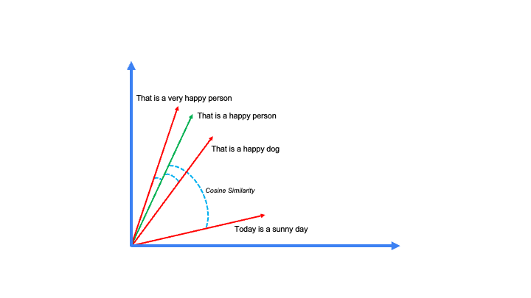
Semantic Similarity

Slide 14
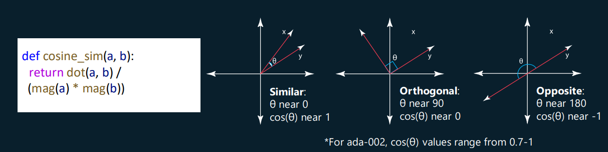
Vector similarity
We compute embeddings so that we can calculate similarity between inputs.
The most common distance measurement is cosine similarity.

Slide 15

Embedding in vector space
Word | Vector embedding
Cat | [1.5, -0.4, 7.2, 19.6, 20.2]
Dog | [1.7, -0.3, 6.9, 19.1, 21.1]
Apple | [-5.2, 3.1, 0.2, 8.1, 3.5]
Strawberry | [-4.9, 3.6, 0.9, 7.8, 3.6]
Building | [81.6, -72.1, 16, -20.2, 102]
Car | [81.6, -72.1, 16, -20.2, 102]
Query: Fruit | [-5.1, 2.9, 0.8, 7.9, 3.1]
Queen = [0.3, 0.9]
King = [0.5, 0.7]
Women= [0.3, 0.4]
Man = [0.5, 0.2]
Queen = [0.3, 0.9]
King = [0.5, 0.7]
Women= [0.3, 0.4]
Man = [0.5, 0.2]

Slide 16
Embedding Model Consideration
Embedding Model Consideration
Dimensions
Cost of generation
Cost of Storage
Cost of indexing
Right model for the right task
Retrieval
Reranking
Summarization
Classification
Clustering
Summarization
Embedding Models used in Information Assistant

Slide 17
MTEB
Embedding Benchmark : https://huggingface.co/spaces/mteb/leaderboard
Vector comparison Demo: https://pamelafox.github.io/vectors-comparison/

Slide 18
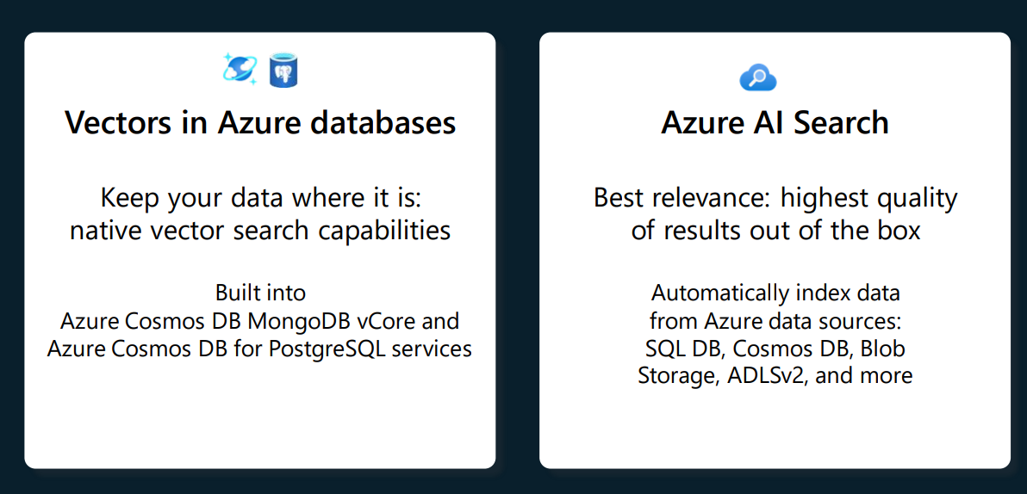
Vector databases in Azure

Slide 19
Azure AI Search
State-of-the-art retrieval system ( keyword, vector, hybrid)
enterprise-ready vector database
Data Encryption
Managed identity and RBAC support
Private endpoints and virtual networks
Compliance certificates for healthcare government
Data and platform integration
Scalability of indexes

Slide 20
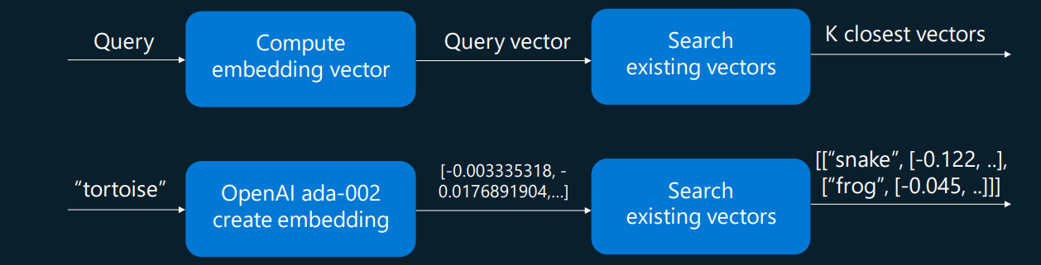
Vector search
1.Compute the embedding vector for the query
2. Find K closest vectors for the query vector
3. Search exhaustively or using approximation ( KNN vs ANN)

Slide 21
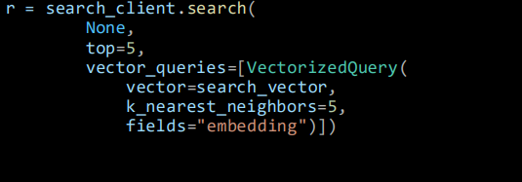
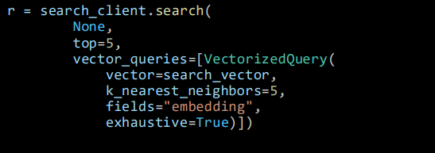
Vector Search
ANN search
ANN = Approximate Nearest Neighbors
Fast vector search at scale Uses HNSW, a graph method
Exhaustive KNN search
KNN = K Nearest Neighbors
Scenarios with highly selective filters
e.g., dense multi-tenant apps

Slide 22
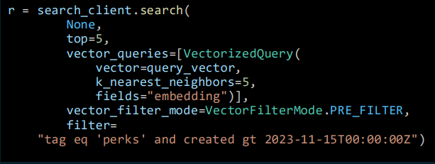
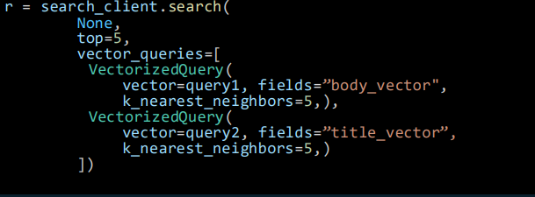
Vector Search Query capabilities
Filtered vector search
Scope to date ranges, categories, geographic distances, access control groups, etc. filter expressions
filtering
Pre-filter: great for selective filters
Post-filter: better for low-selectivity filters
Multi-vector scenarios
Multiple vector fields per document
Multi-vector queries
mix and match as needed

Slide 23
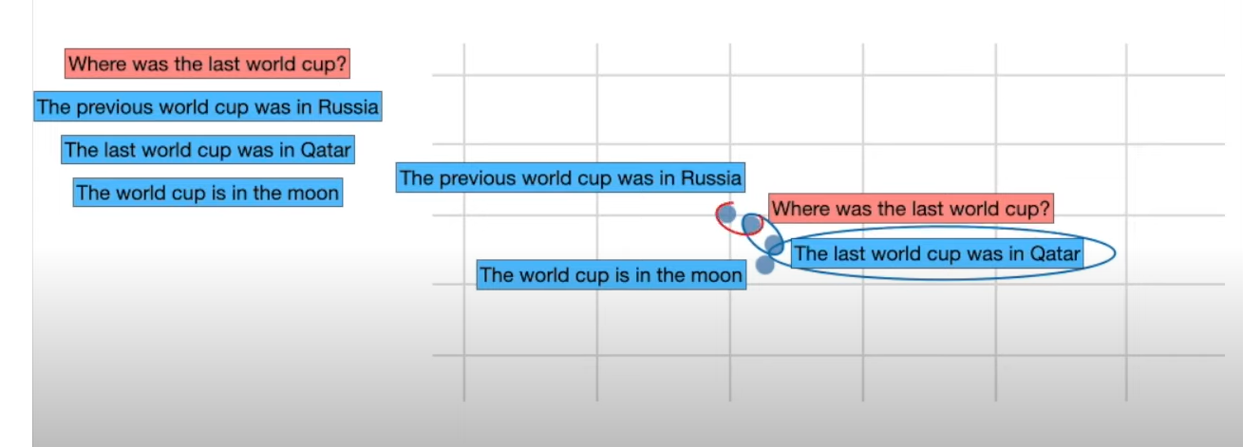
Just vector isn’t enough

Slide 24
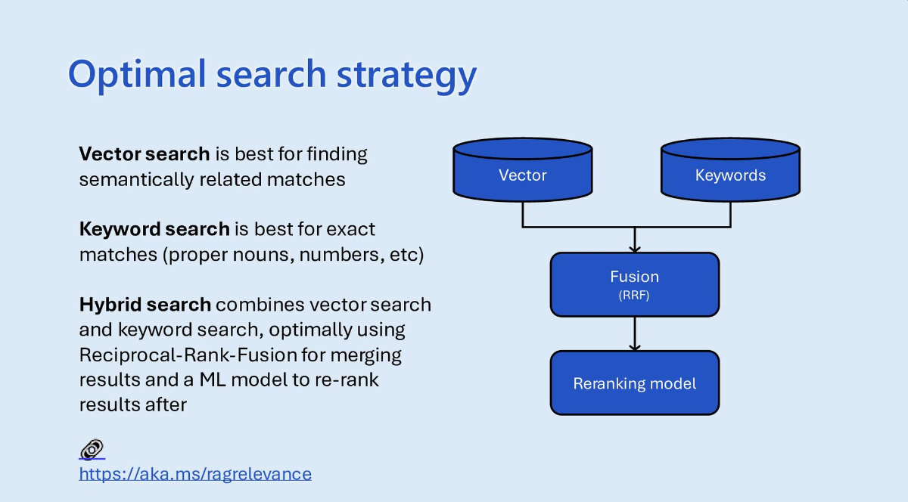
Hybrid Search
Source: https://speakerdeck.com/pamelafox/vector-search-and-retrieval-for-generative-ai-app-microsoft-ai-tour-sf

Slide 25
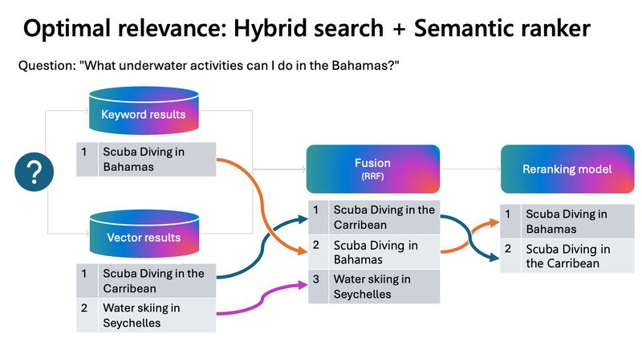
Hybrid Search

Slide 26
Vector DB | Hybrid Search | Native Reranking
Azure AI Search | ✅ | ✅
ElasticSearch | ✅ | ✅ (with plugins)
Weaviate | ✅ | ❌
Pinecone | ✅ | ❌
Milvus | ✅ | ❌
Qdrant | ✅ | ❌
Redis | ✅ | ❌
Faiss | ❌ | ❌

Slide 27
Semantic Ranking ( L2 ranking)
re-ranking model out of box
Highest performing retrieval mode
Pay as you go pricing
Free 1k requests/month

Slide 28
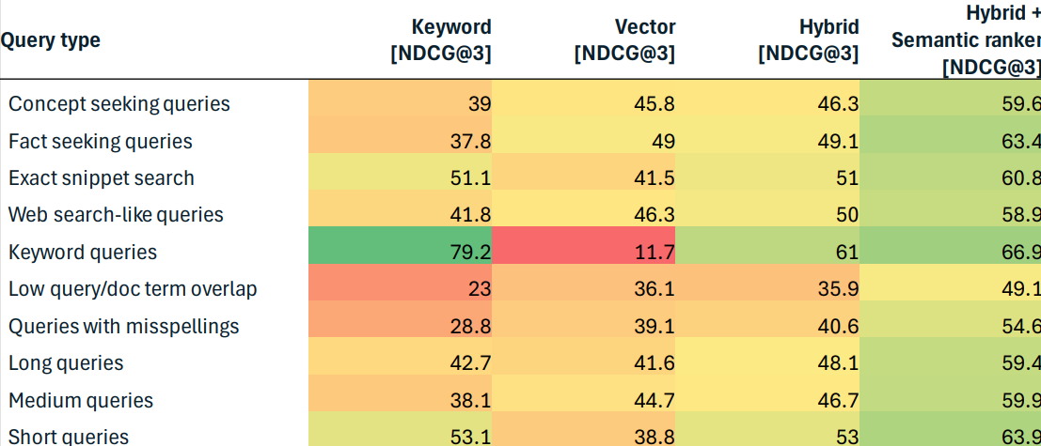
Query type and relevance
Source: Outperforming vector search with hybrid + reranking:
https://techcommunity.microsoft.com/t5/azure-ai-services-blog/azure-cognitive-search-outperforming-vector-search-with-hybrid/ba-p/3929167

Slide 29
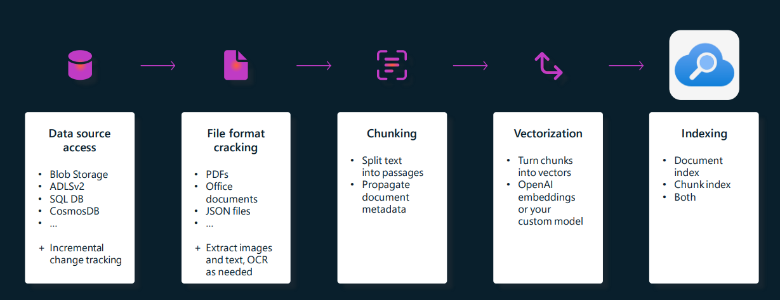
Integrated Vectorization ( vectorization as a service)

Slide 30
Integrated Vectorization in Azure AI Search
https://learn.microsoft.com/en-us/azure/search/search-get-started-portal-import-vectors?tabs=sample-data-storage%2Cmodel-aoai%2Cconnect-data-storage

Slide 31
Lab
Github: https://github.com/ArpitaisAn0maly/BootcampAIArchitect/tree/main/Session2

Slide 32
Resources: White Paper on improving search relevance
Improving RAG performance with Azure AI Search and Azure AI prompt flow in Azure AI Studio | Microsoft Community Hub - Arpita Parmar

Slide 33
Q & A

